Slide 1
Michigan Rehabilitation Services • MRS
Michigan Department of Labor and Economic Opportunity Employment and Training

Slide 2
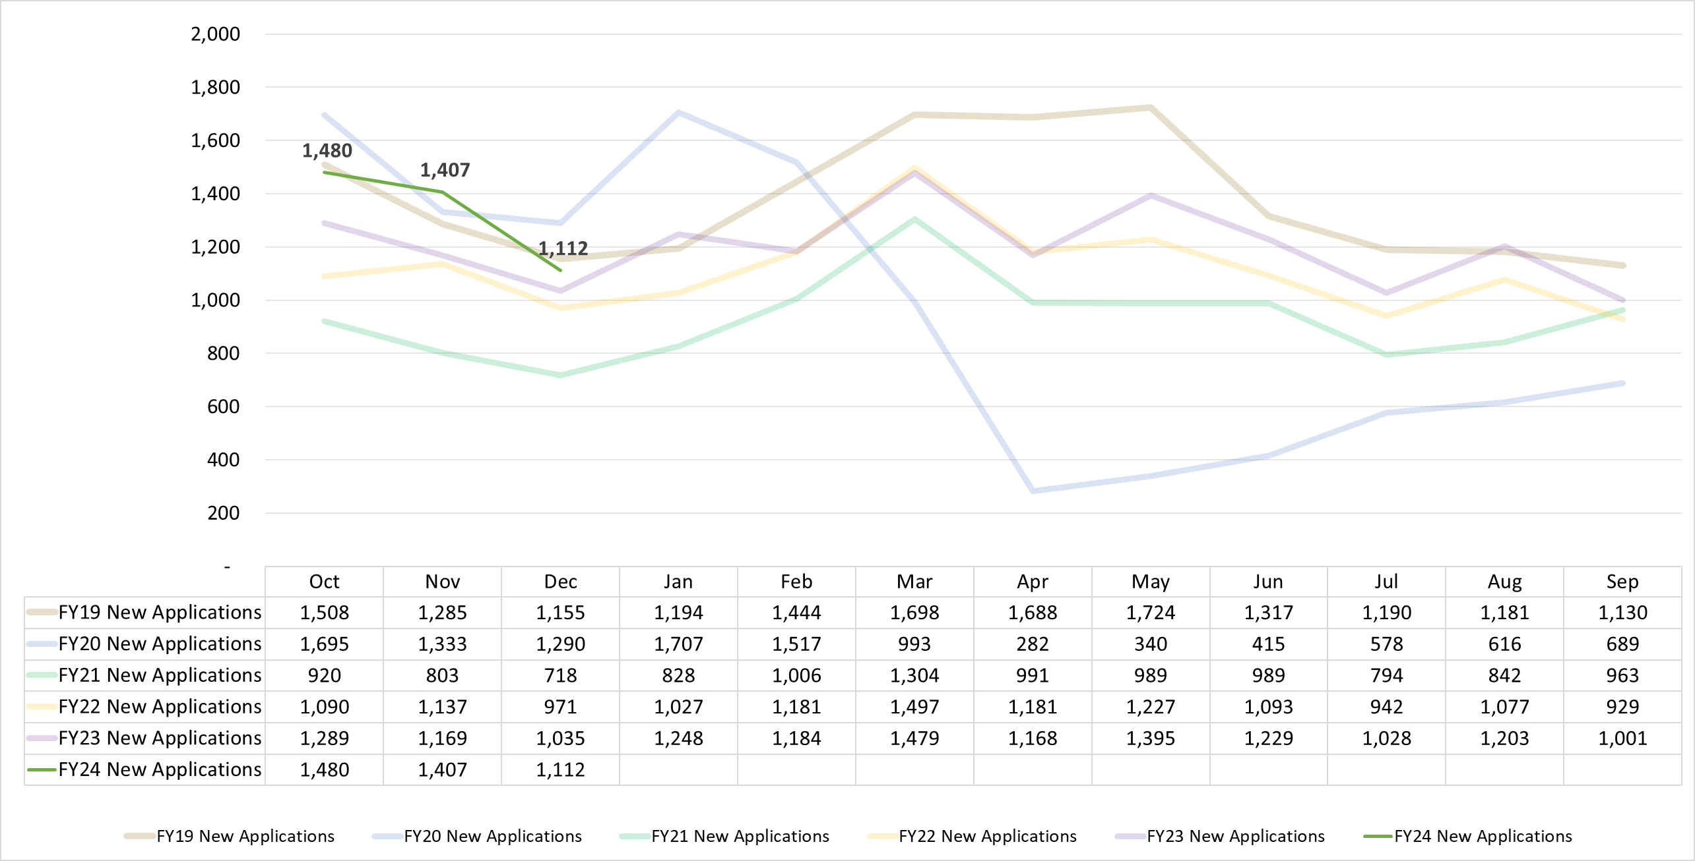
MRS Performance – New VR Applications
Year-to-date (YTD) Cumulative Totals – New Applications
Fiscal Year | Cases
FY24 (Oct-Dec): | 3,999
FY23 (Oct-Dec): FY23 Year End: | 3,493 14,428
FY22 (Oct-Dec): FY22 Year End: | 3,198 13,352
FY21 (Oct-Dec): FY21 Year End: | 2,453 11,159
FY20 (Oct-Dec): FY20 Year End: | 4,318 11,455
FY19 (Oct-Dec): FY19 Year End: | 3,948 16,514
MICHIGAN REHABILITATION SERVICES

Slide 3
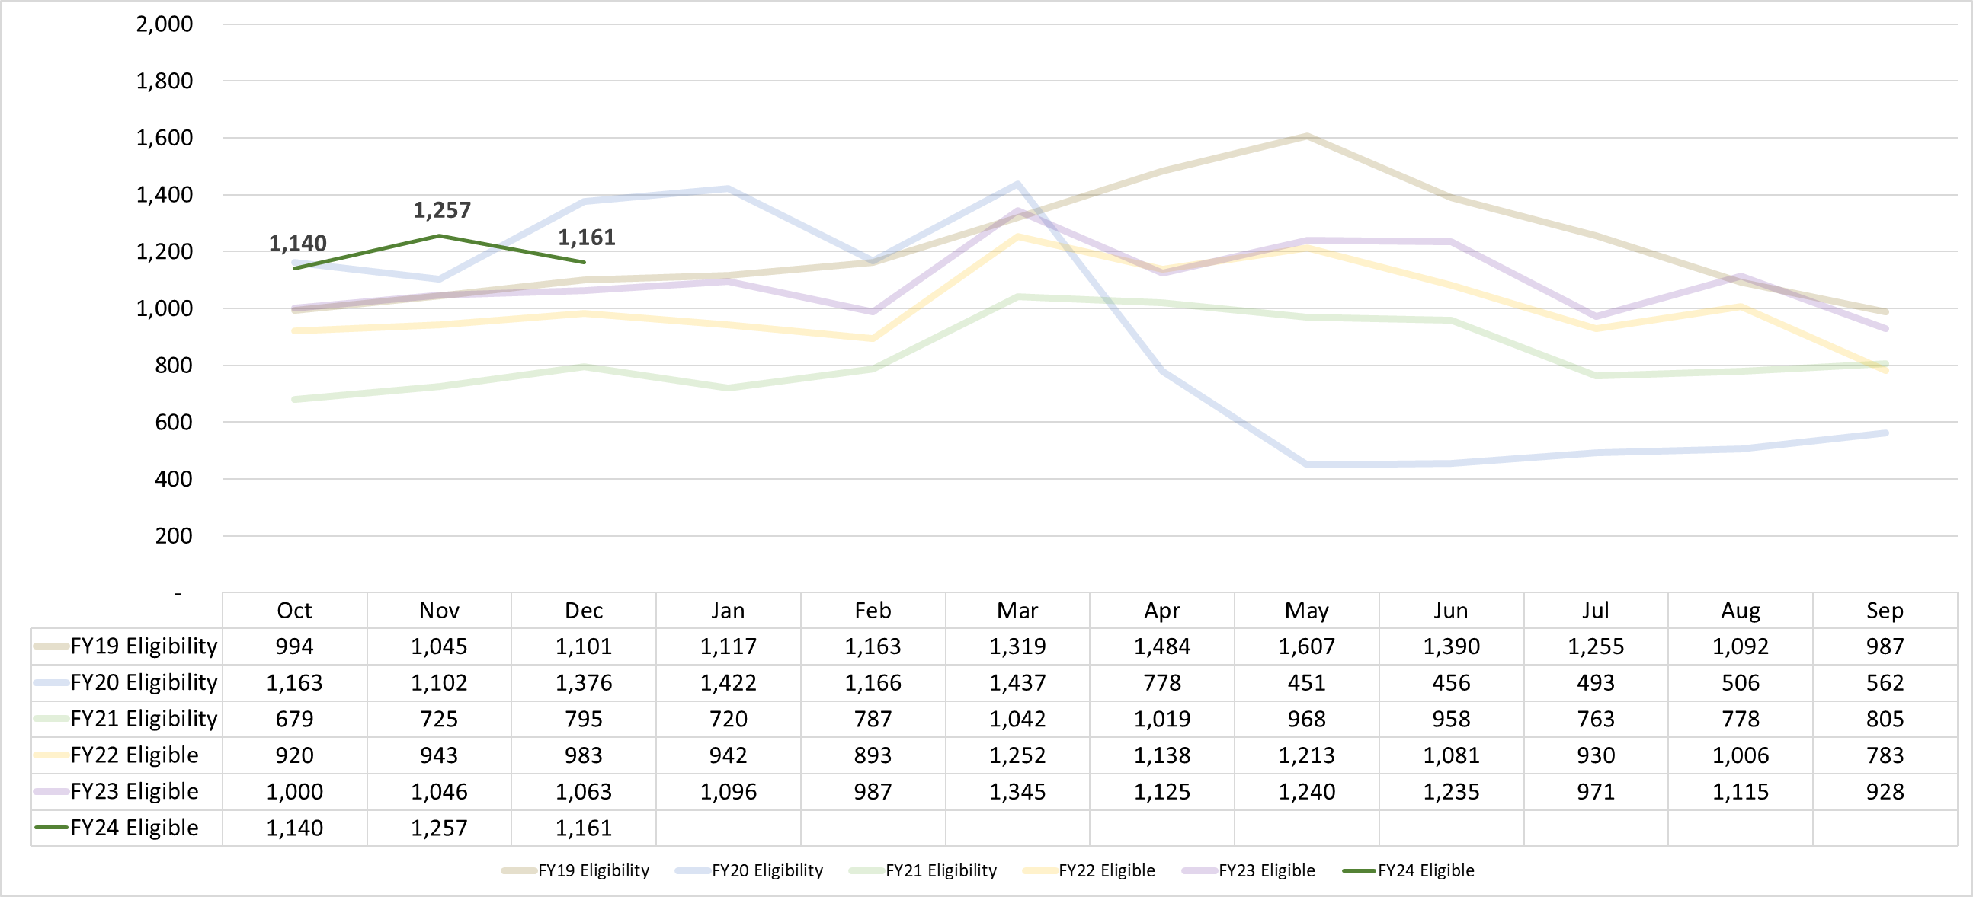
MRS Performance – Eligibility
Year-to-date (YTD) Cumulative Totals - Eligibility
Fiscal Year | Cases
FY24 (Oct-Dec): | 3,558
FY23 (Oct-Dec):: FY23 Year End: | 3,109 13,151
FY22 (Oct-Dec): FY22 Year End: | 2,846 12,084
FY21 (Oct-Dec): FY21 Year End: | 2,199 10,039
FY20 (Oct-Dec): FY20 Year End: | 3,641 10,912
FY19 (Oct-Dec): FY19 Year End: | 3,140 14,554
MICHIGAN REHABILITATION SERVICES

Slide 4
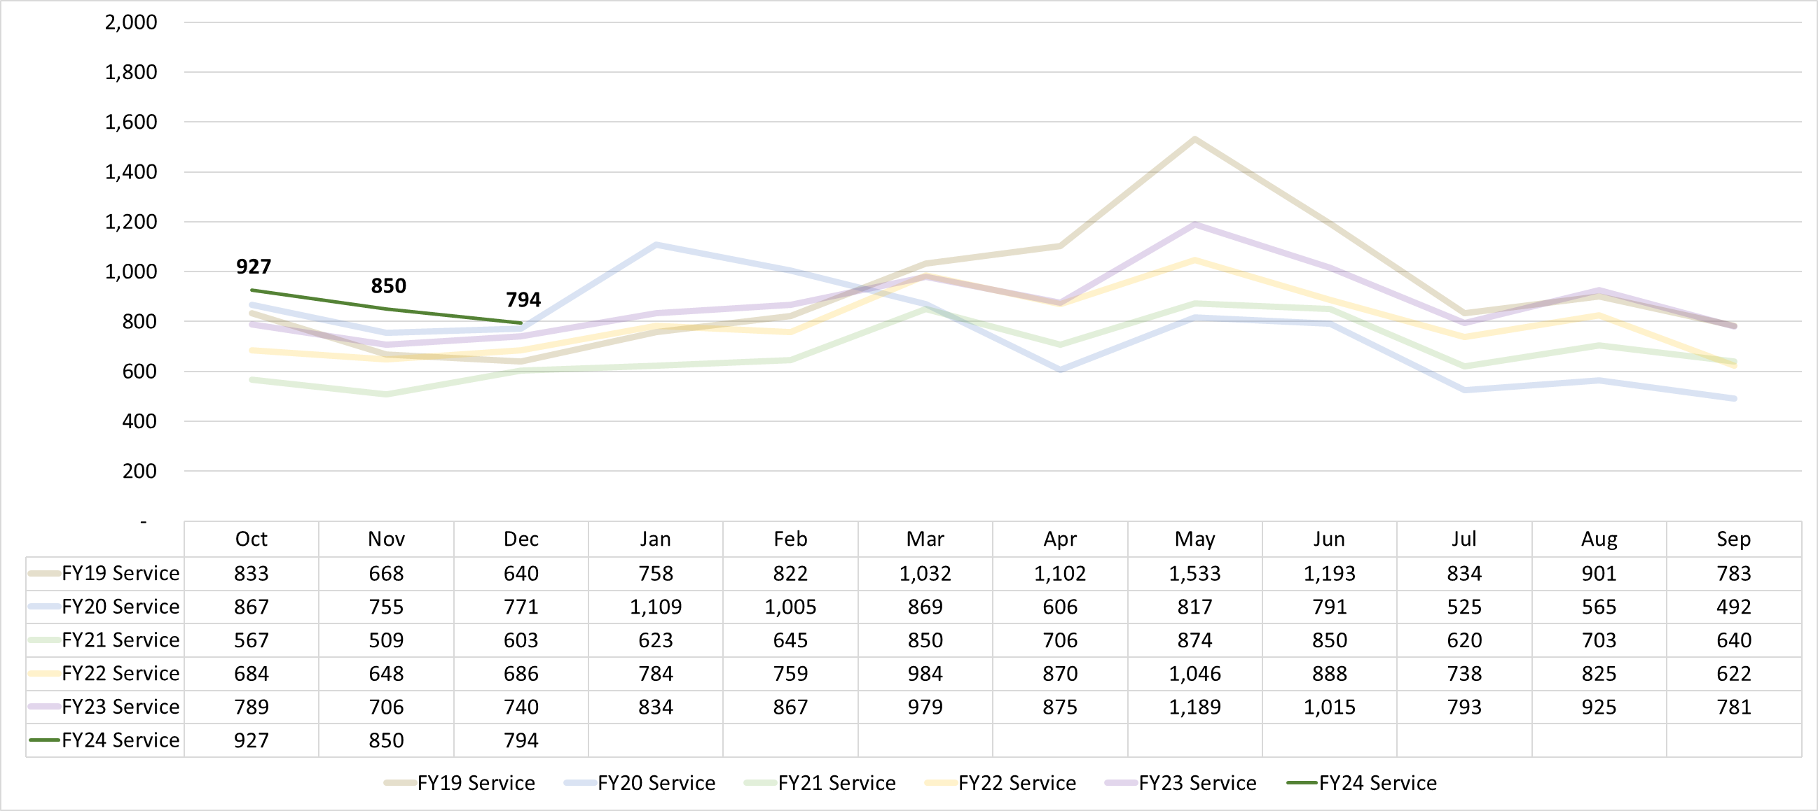
MRS Performance – Service / IPE
Year-to-date (YTD) Cumulative Totals – Service/IPE
Fiscal Year | Cases
FY24 (Oct-Dec): | 2,571
FY23 (Oct-Dec): FY23 Year End: | 2,231 10,493
FY22 (Oct-Dec): FY22 Year End: | 2,018 9,534
FY21 (Oct-Dec): FY21 Year End: | 1,681 8,192
FY20 (Oct-Dec): FY20 Year End: | 2,393 9,172
FY19 (Oct-Dec): FY19 Year End: | 2,141 11,099
MICHIGAN REHABILITATION SERVICES

Slide 5
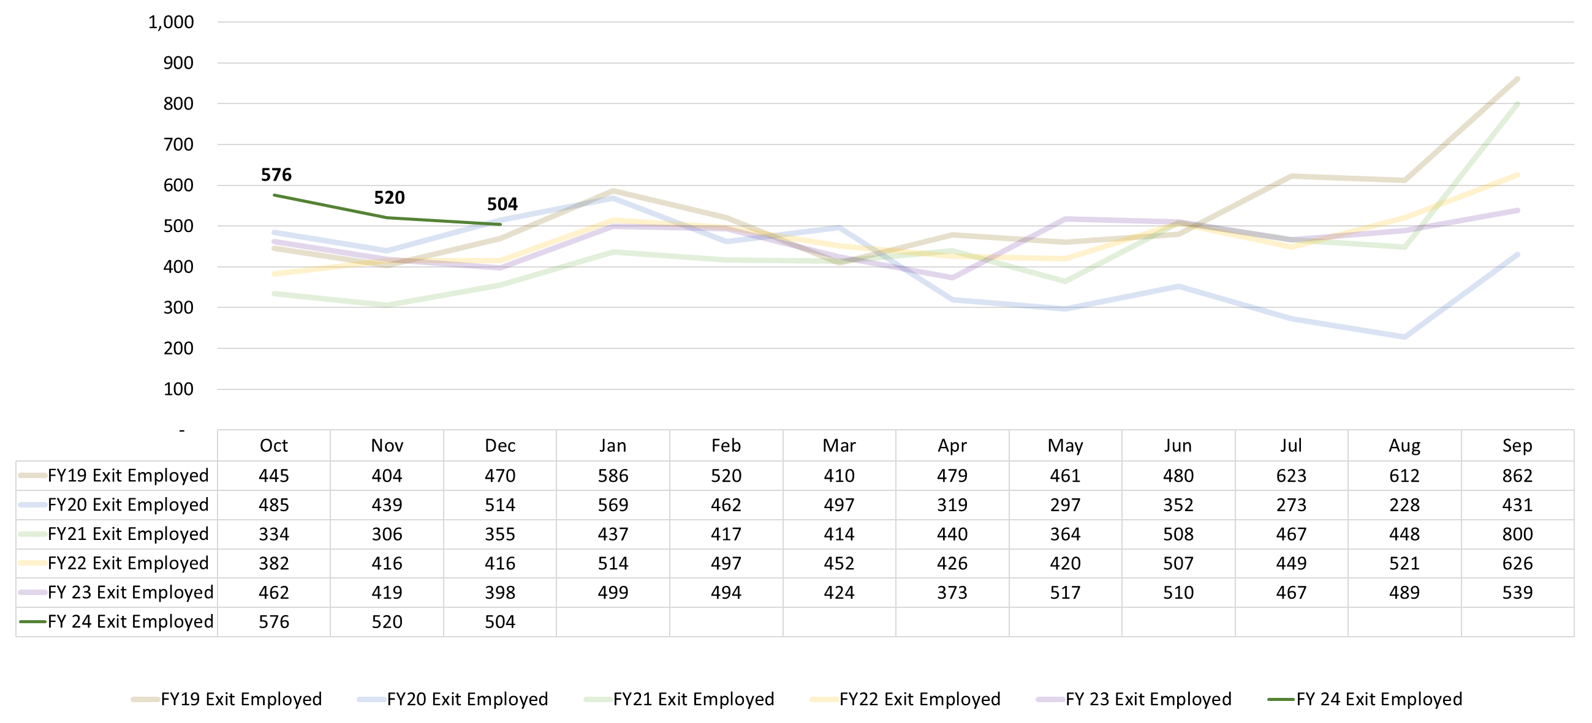
MRS Performance – Exit Employed
Year-to-date (YTD) Cumulative Totals – Exit Employed
Fiscal Year | Cases
FY24 (Oct-Dec): | 1,600
FY23 (Oct-Dec): FY23 Year End: | 1,279 5,591
FY22 (Oct-Dec): FY22 Year End: | 1,214 5,626
FY21 (Oct-Dec): FY21 Year End: | 995 5,290
FY20 (Oct-Dec): FY20 Year End: | 1,438 4,866
FY19 (Oct-Dec): FY19 Year End: | 1,319 6,352
MICHIGAN REHABILITATION SERVICES

